Slide 1


Mithun Nagesh Shet
18/04/2022

Slide 2

Outline
Executive Summary
Introduction
Methodology
Results
Conclusion
Appendix

Slide 3

Executive Summary
Summary of methodologies
Data Collection through API and Web Scraping
Data Wrangling
Exploratory Data Analysis with SQL
Exploratory Data Analysis with Data Visualization
Interactive Visual Analytics with Folium
Building Interactive Dashboard with Plotly
Predictive Analysis
Summary of all results
Exploratory Data Analysis result
Interactive analytics of Dashboard through screenshots
Predictive Analysis result

Slide 4

Introduction
Project background and context
Space X advertises Falcon 9 rocket launches on its website with a cost of 62 million dollars; other providers cost upward of 165 million dollars each, much of the savings is because Space X can reuse the first stage. Therefore, if we can determine if the first stage will land, we can determine the cost of a launch. This information can be used if an alternate company wants to bid against space X for a rocket launch. The goal of this project is to study the launch data and find a predictive model to predict if the first stage of Falcon 9 rocket will land successfully or not.
Problems you want to find answers
What are the different attributes that contribute for the successful landing of Boosters?
The relationship of the attributes with booster landing.
What attributes help SpaceX to achieve best landing rates of their boosters.

Slide 5

Section 1

Slide 6
Methodology
Executive Summary
Data collection methodology:
SpaceX Rest API
Webscrapping from Wikipedia
Performed data wrangling
The data was collected through get_request from Spacex API. The response content was a Json file and was retrieved using .json() function call and was converted to a pandas dataframe using .json_normalize().
The categorical data was One Hot Encoded and irrelevant columns were dropped.
Performed exploratory data analysis (EDA) using visualization and SQL
Plots such as scatter plots,bar plots,regplot were used to find the relationship between variables.
Performed interactive visual analytics using Folium and Plotly Dash
Performed predictive analysis using classification models to build, tune, evaluate classification models

Slide 7
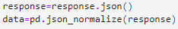
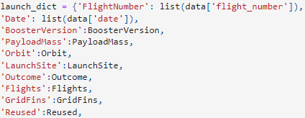
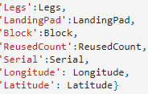
Data Collection – SpaceX API
1 .Getting Response from API
Get request to the SpaceX API to collect data, used custom functions to extract data, cleaned the requested data and assigned to new variable names. The null values in Payload_mass was replaced by mean value.
Finally the Dataframe was exported as csv file.
The Github url of the file:
Spacex_project/Data Collection API Lab.ipynb at master · Mith1201/Spacex_project (github.com)
2 . Use json_normalize method to convert the json result into a dataframe
3 . Use custom functions to extract data
4 . Construct the dataset using the data obtained and combine the columns into a dictionary.
5 . Extract data for Falcon 9 and export to csv

Slide 8
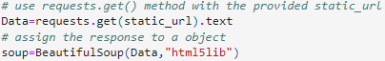
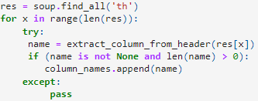
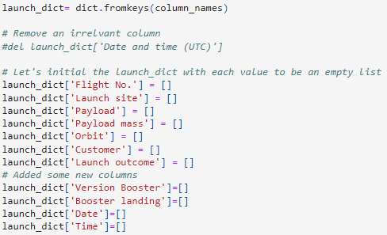
Data Collection - Scraping
1 . Request the Falcon9 Launch Wiki page from its URL and create Beautifulsoup object
The data was scraped from the wikipage using BeautifulSoup .
The columns were renamed and relevant columns from table for Falcon 9 was retrieved.
The new Dataframe was later exported as csv.
The Github url of the file:
Spacex_project/Data Collection with webscrapping.ipynb at master · Mith1201/Spacex_project (github.com)
2 . Extract all column/variable names from the HTML table header
3 . Create a data frame by parsing the launch HTML tables and export to csv

Slide 9
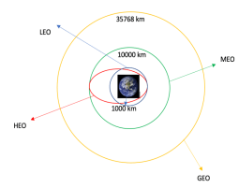
Data Wrangling
Introduction
In the data set, there are several different cases where the booster did not land successfully. Sometimes a landing was attempted but failed due to an accident; for example, True Ocean means the mission outcome was successfully landed to a specific region of the ocean while False Ocean means the mission outcome was unsuccessfully landed to a specific region of the ocean. True RTLS means the mission outcome was successfully landed to a ground pad False RTLS means the mission outcome was unsuccessfully landed to a ground pad. True ASDS means the mission outcome was successfully landed on a drone ship False ASDS means the mission outcome was unsuccessfully landed on a drone ship.
Here we will mainly convert those outcomes into Training Labels with 1 means the booster successfully landed 0 means it was unsuccessful.
Process
Perform EDA on dataset
Calculate the number of launches at each site
Calculate the number and occurrence of each orbit
Export dataset as .CSV
Create a landing outcome label from Outcome column
Create a Class variable with successful landing is assigned to 1 and unsuccessful to 0
Common Orbit types used by Spacex:
Github Url for notebook

Slide 10
EDA with Data Visualization
Scatter Graphs used for:
Flight Number VS. Payload Mass
Flight Number VS. Launch Site
Payload VS. Launch Site
Orbit VS. Flight Number
Payload VS. Orbit Type
Orbit VS. Payload Mass
Scatter plots are used to determine the correlation between different variables.
Bar Graph used for:
Mean Success Rate VS Orbit
Bar graph gives a good comparison between different categories. Highest success rate was found in ESL1,GEO,HEO and SSO.
Line Graph used for:
Success Rate VS Year
Line graph gives trends of variables over the period of time and also good vizualization for predictions
Its clearly seen the success rate has improved over the years from time of its inception.
Github Url for Notebook

Slide 11
EDA with SQL
Created service credentials to access database in jupyter notbook.
Created schema in DB2 and spaceX dataset was uploaded which was used to extract information using sql.
Task 1 included displaying the names of the unique launch sites in the space mission.
Task 2 included displaying 5 records where launch sites begin with the string 'CCA‘.
Task 3 included displaying the total payload mass carried by boosters launched by NASA (CRS).
Task 4 included displaying average payload mass carried by booster version F9 v1.1.
Task 5 included listing the date when the first successful landing outcome in ground pad was achieved.
Task 6 included listing the names of the boosters which have success in drone ship and have payload mass greater than 4000 but less than 6000.
Task 7 included listing the total number of successful and failure mission outcomes.
Task 8 included listing the names of the booster versions which have carried the maximum payload mass.
Task 9 included listing the failed landing outcomes in drone ship, their booster versions, and launch site names for in year 2015
Task 10 included Rank the count of landing outcomes (such as Failure (drone ship) or Success (ground pad)) between the date 2010-06-04 and 2017-03-20, in descending order
Github Url Link for notebook

Slide 12
Build an Interactive Map with Folium
Marked all launch sites, and added map objects such as markers, circles, lines to mark the success or failure of launches for each site on the folium interactive map. The information of Latitudes and Longitudes for respective launch sites were extracted from the table for marking purpose.
We assigned the launch_outcomes with 0(failure) and 1 (Success) to Green and Red markers on the map in cluster.(MarkerCluster()).
We calculated the distance from the Launch site to landmarks at its close proximity such as Railways,Airports,coast etc. Lines were drawn on the map for better visualization of the proximity from launch sites.
This helped us answer some questions like:
Are launch sites close to railway?
Are launch sites close to coast line?
Are launch site close to highways?
Are launch sites close to city center?
Github Url for notebook

Slide 13
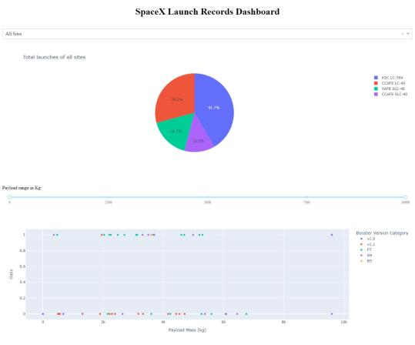
Build a Dashboard with Plotly Dash
Interactive Dashboard was built using Plotly Dash.
The pie chart showing the total launches for All Sites or specific launch sites.
The pie chart also provides information about successful(Class 1) and unsuccessful(Class 0) launches for specific launch sites.
The scatter graph showing the relationship with Outcome and Payload Mass(Kg) for the different booster versions.
Github Url link for notebook

Slide 14
Predictive Analysis (Classification)
Building Model
Load our dataset into NumPy and Pandas
Split our data into training and test data sets
Evaluating the Model
Check the accuracy for each model
Get optimized hyperparameters for each type of algorithms
Find the best performing classification model
The model with best accuracy score is the best performing model
For our study, Tree model was found best classification model
Normalize the data
Set our parameters and algorithms to GridSearchCV for our ML Models
Fit our datasets into the GridSearchCV objects and train our dataset.
Plot confusion Matrix to check the performance of the model
Github Url for the notebook

Slide 15

Results
Exploratory data analysis results
Interactive analytics demo in screenshots
Predictive analysis results

Slide 16

Section 2

Slide 17
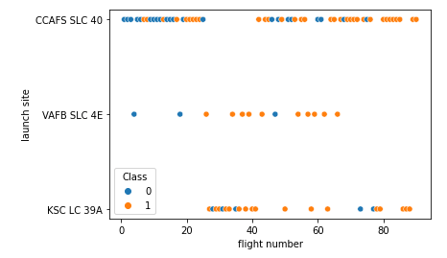
Flight Number vs. Launch Site
From the plot, it can be found that the larger the amount of flights at a launch site, the greater the success rate at a launch site.

Slide 18
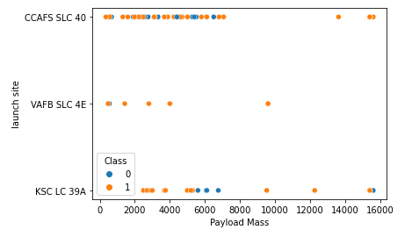
Payload vs. Launch Site
We can observe that VAFB-SLC launch site there are no rockets launched for heavy payload mass(greater than 10000)
It can also be seen that success rate is higher for higher payload mass.
There is no clear pattern between the launch site and payload mass and hence hard to interpret its effect on success rate.

Slide 19
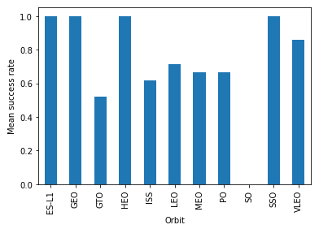
Success Rate vs. Orbit Type
From the bar graph , we can observe Orbits ES-L1,GEO,HEO,SSO have best success rate.
The orbit SO has almost zero success rate.

Slide 20
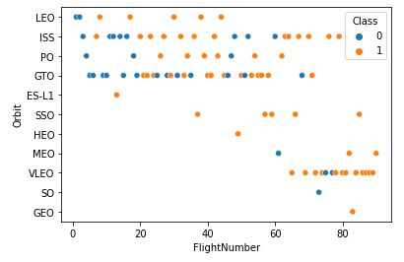
Flight Number vs. Orbit Type
We observe that in the LEO orbit the Success appears related to the number of flights; on the other hand, there seems to be no relationship between flight number when in GTO orbit.

Slide 21
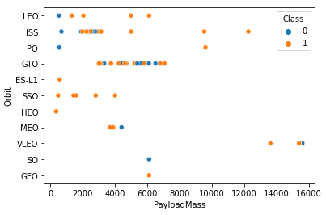
Payload vs. Orbit Type
We observe that with heavy payloads the successful landing or positive landing rate are more for Polar,LEO and ISS
However for GTO we cannot distinguish this well as both positive landing rate and negative landing(unsuccessful mission) are both there here.

Slide 22
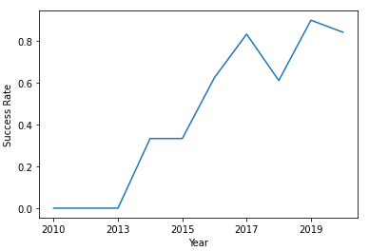
Launch Success Yearly Trend
We observe that success rate has shown a increasing trend from 2010 with highest observed in the year 2019.

Slide 23
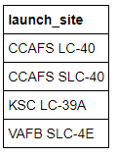
SQL Query
All Launch Site Names
%sql Select DISTINCT(launch_site )
From spacextbl
Explanation:
We use Distinct in the query to show unique launch sites from table spacextbl

Slide 24
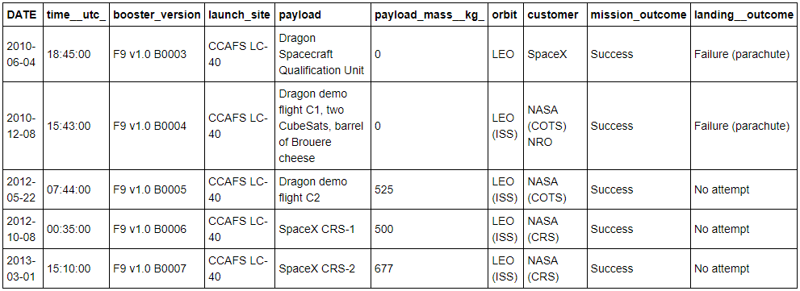
Launch Site Names Begin with 'CCA'
SQL Query
%%sql select * from spacextbl where launch_site like 'CCA%' limit 5;
Explanation:
We use LIKE keyword as wildcard with words ‘CCA%’ to filter out launch_site starting with CCA. LIMIT 5 is used to limit the result to 5 rows.

Slide 25
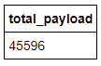
Total Payload Mass
SQL Query
%%sql select sum(payload_mass__kg_) as total_payload from spacextbl where customer='NASA (CRS)';
Explanation:
SUM summates the total in the column payload_mass_kg. The WHERE clause filters the results to customer NASA(CRS).

Slide 26
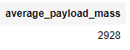
Average Payload Mass by F9 v1.1
SQL Query
%%sql select avg(payload_mass__kg_) as average_payload_mass from spacextbl
where booster_version like 'F9 v1.1';
Explanation:
Function AVG is used to calculate the average in the column payload_mass__kg. The WHERE clause filters results to booster version ‘F9 v1.1’

Slide 27
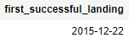
First Successful Ground Landing Date
SQL Query
%%sql select min(Date) as first_successful_landing from spacextbl
where landing__outcome like '%ground pad%';
Explanation:
MIN function is used to find the date of first successful ground landing. LIKE is used as wildcard to filter landing_outcome with groundpad with successful landing.

Slide 28
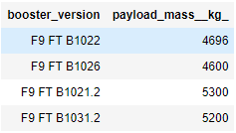
Successful Drone Ship Landing with Payload between 4000 and 6000
SQL Query
%%sql select booster_version,payload_mass__kg_ from spacextbl
where landing__outcome = ‘Success (drone ship)' and payload_mass__kg_ between 4000 and 6000;
Explanation:
Queried booster_version and payload_mass_kg from table spacextbl. WHERE clause is used to filter the data for successful landing for drone ship with payload mass between 4000 and 6000.

Slide 29
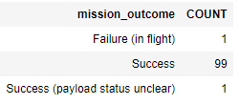
Total Number of Successful and Failure Mission Outcomes
SQL Query
%sql Select MISSION_OUTCOME,count(MISSION_OUTCOME) as count from SPACEXTBL GROUP BY MISSION_OUTCOME;
Explanation:
Queried Mission_outcome and its COUNT from spacextbl with results grouped by Mission_outcome.

Slide 30
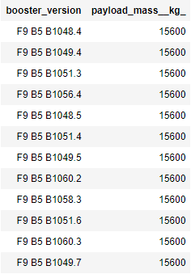
Boosters Carried Maximum Payload
SQL Query
%%sql select booster_version,payload_mass__kg_ from spacextbl
where payload_mass__kg_ in (select max(payload_mass__kg_) from spacextbl);
Explanation:
Queried Booster_version and payload mass from spacextbl with payload mass was subqueried from spacextbl using MAX function to get maximum payload for respective booster version.

Slide 31
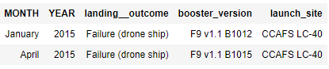
2015 Launch Records for Failed Landing of Droneship
SQL Query
%%sql select monthname(Date) as Month,year(Date) as Year,landing__outcome,booster_version,launch_site from spacextbl
where landing__outcome in 'Failure (drone ship)' and year(DATE)=2015;
Explanation:
Queried month,Year,landing_outcome,Booster version and Launch site from table spacextbl. WHERE clause used to filter the results with landing outcome as ‘Failure(drone ship)’ fot the year 2015.

Slide 32
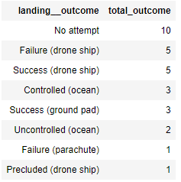
Rank Landing Outcomes Between 2010-06-04 and 2017-03-20
SQL Query
%%sql select landing__outcome,count(landing__outcome) as total_outcome from spacextbl
Where Date>'2010-06-04' and Date<'2017-03-20'
group by landing__outcome order by count(landing__outcome) desc;
Explanation:
Queried landing outcome and its COUNT from spacextbl. WHERE clause used to filter the landing outcome between 2010-06-04 and 2017-03-20. The results were ranked based on highest total outcome using Order By DESC clause.

Slide 33

Section 3

Slide 34

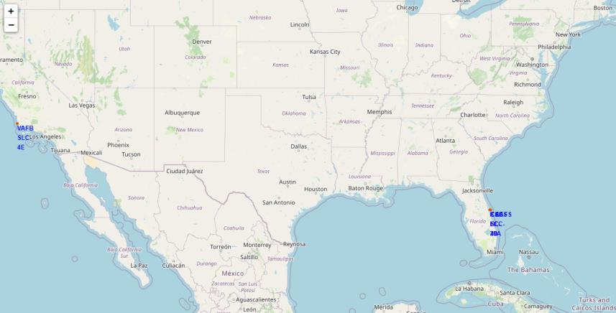
All Launch sites in USA
The folium map shows the launch sites in USA located at California and Florida

Slide 35
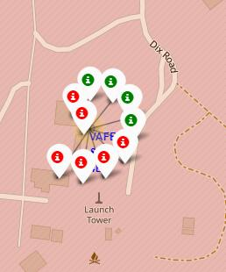
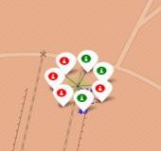
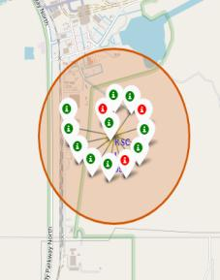
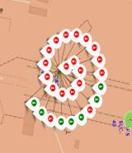
Labeled Markers for Launch sites
CCAFS SLC-40
VAFCSLC-4E
CCAFS LC-40
Florida Launch site with green marker showing successful launches and Red marker showing Failure
California Launch site with green marker showing successful launches and Red marker showing Failure

Slide 36
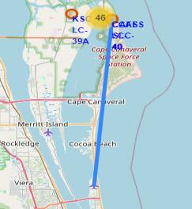
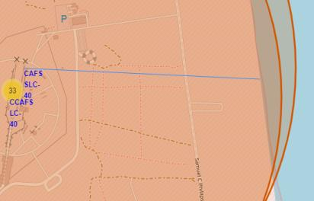
Proximity of Launch site to nearest Landmarks
36.6 KM
0.89 KM
Distance to nearest Patrik Space force base
Distance to nearest Coast Line
The distance is about 36.6 km and is not in close proximity to nearest flight zone
The distance is about 0.89 km from CAFSSLC-40 and is in close proximity to coast.

Slide 37

Section 4

Slide 38
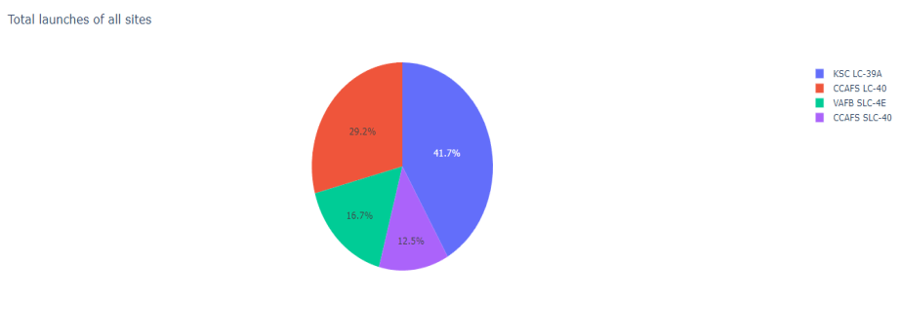
Dashboard Pie chart showing success percentage of all launch sites
KSC LC-39A had the most successful launch perecntage of all launch sites

Slide 39
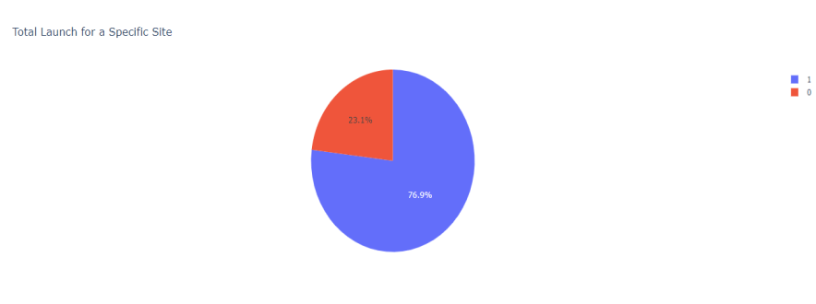
Dashboard Piechart for launch site with highest success rate
KSC LC-39A had a success rate of 76.9% and failure of 23.1%.

Slide 40
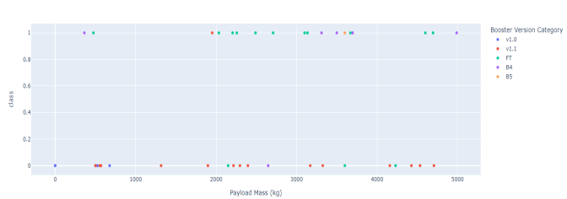
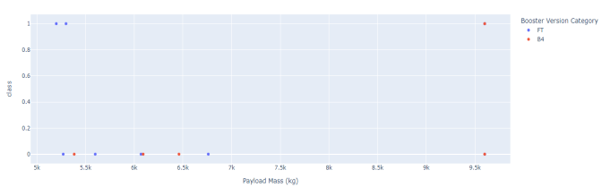
Dashboard- Scatter plot for payload VS Success rate(Class) for all launch sites
Payload Mass between 0 to 5000 kg
Success rates observed for lower payload was higher.
Booster version FT showed good success rate for lower payload mass
Payload Mass between 5000 to 10000 kg
Success rates observed for higher payload was lower.
Booster version FT showed good success rate for higher payload mass within 5500 kg.

Slide 41

Section 5

Slide 42

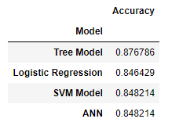
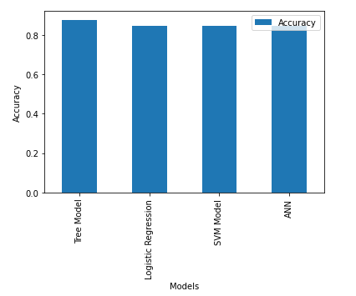
Classification Accuracy
Tree Model showed highest Accuracy among the classification models with an accuracy of 87.67%.
The optimised parameters obtained from Grid search for tree classification model is:
tuned hpyerparameters :(best parameters) {'criterion': 'entropy', 'max_depth': 12, 'max_features': 'sqrt', 'min_samples_leaf': 1, 'min_samples_split': 10, 'splitter': 'random'}
The model showed an accuracy of 83.33% on Test data

Slide 43

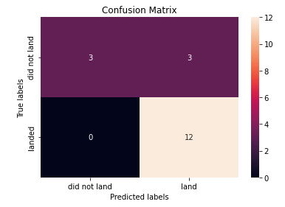
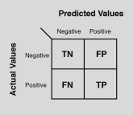
Confusion Matrix
The confusion matrix for the decision tree classifier shows that the classifier can distinguish between the different classes. The major problem is the false positives .i.e., unsuccessful landing marked as successful landing by the classifier.

Slide 44
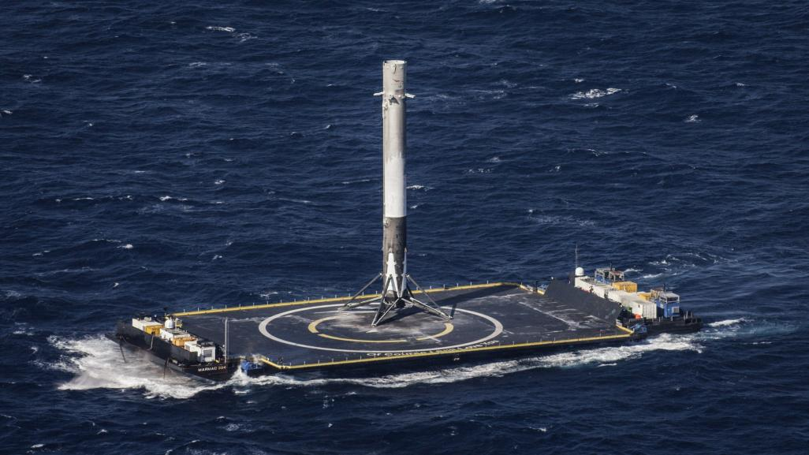
Conclusions
Higher success rates was found for lower payload mass(within 5.5 tons) and booster version FT performed well.
The success rate for Spacex launches have improved significantly from 2010 to present.
The launch site KSC LC-39A had highest number of successful launches.
The orbits used by Spacex like GEO,HEO,SSO,ES-L1 had highest success rate and orbit SO had amost zero success rate.
Tree Classification model showed better accuracy among classification models and will be good model to predict future launches for higher success rate.

Slide 45

Appendix
IBM Watson studio
SQL DB2 relational database
Jupyter notebook with python libraries.
Plotly Dash
Folium interactive map
Scikit learn Library
Haversine formula to measure distance on maps

Slide 46


